Slide 1
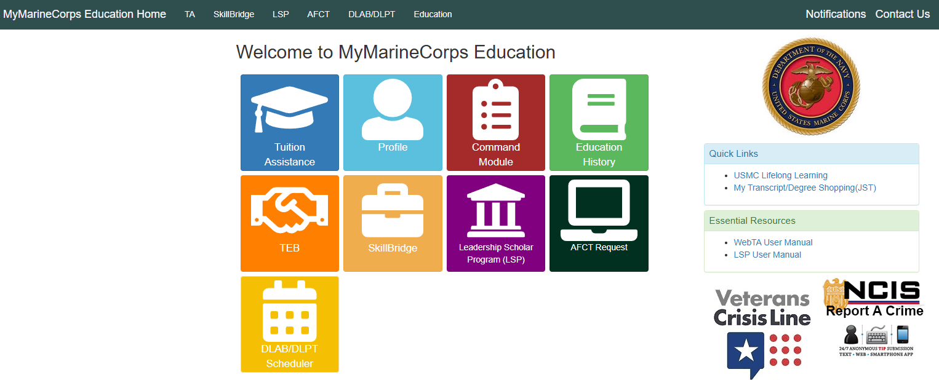
Marine Corps SkillBridge User Guide
Welcome to MyMarineCorps Education!

Slide 2
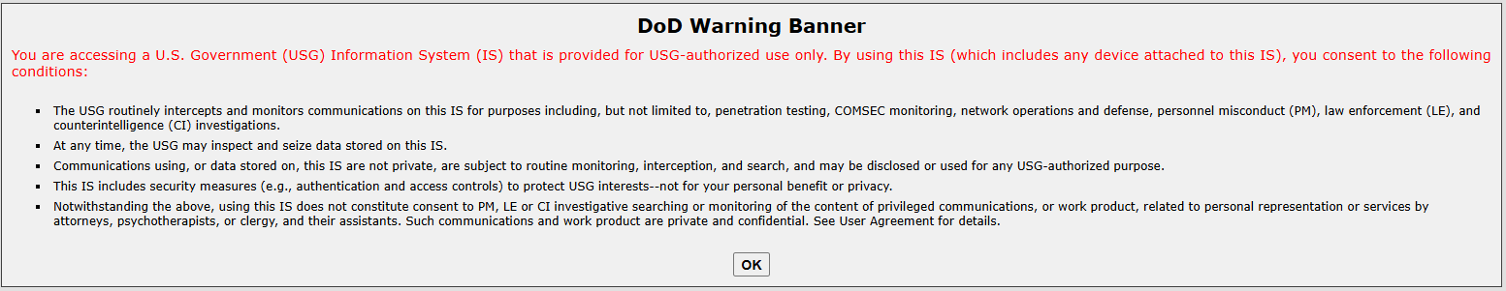
Login to MyMarineCorps Education
Visit the Navy College Program website at https://www.navycollege.navy.mil, and look for MyNavy Education Login the upper right corner of the landing page.
Direct link to MyMarineCorps Education: https://myeducation.netc.navy.mil/webta/home.html#nbb
You can only access the MyMarineCorps Education website with a CAC.

Slide 3
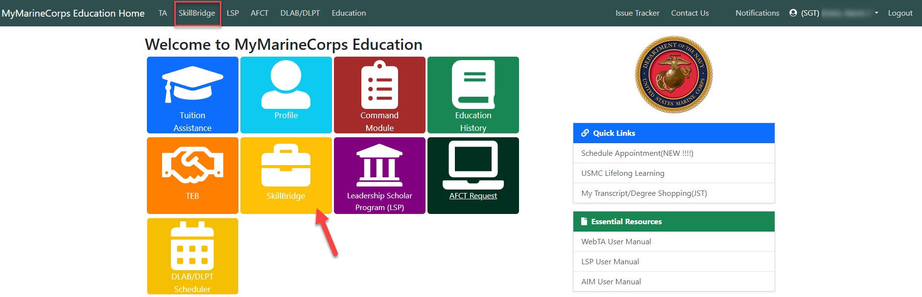
Access SkillBridge Application
Select SkillBridge from the navigation bar or the “SkillBridge” tile on the homepage, to create a SkillBridge application.

Slide 4
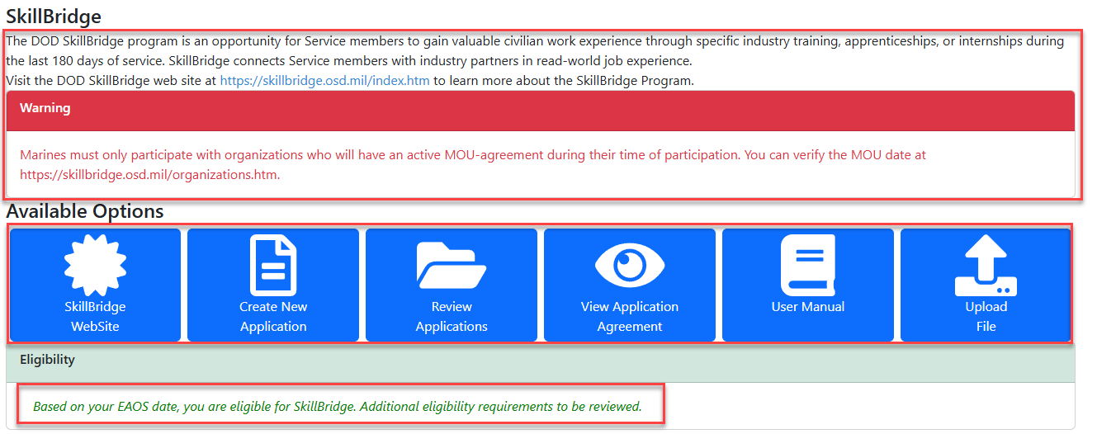
SkillBridge Landing Page
The SkillBridge landing page lists information concerning the SkillBridge program.
The “Available Options” has six tiles: DoW SkillBridge website, create new application, review previous applications, view application agreement, user manual and upload files.
The “Eligibility” section will if you are not eligible to create a SkillBridge application.

Slide 5
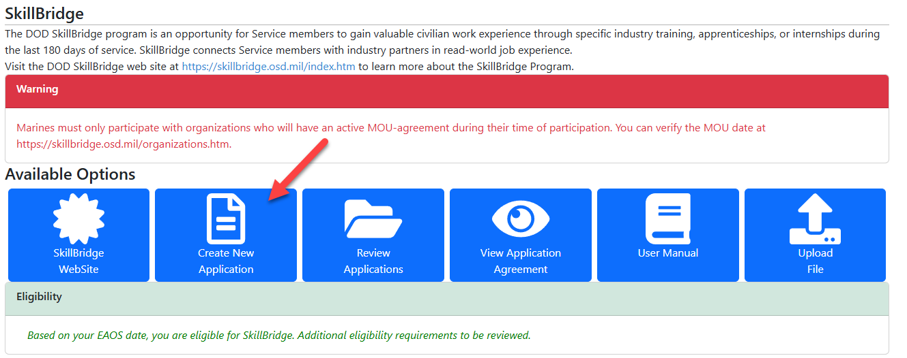
Create SkillBridge Application
When MyMarineCorps Education shows you’re eligible, select the “Create New Application” tile start your SkillBridge application.

Slide 6
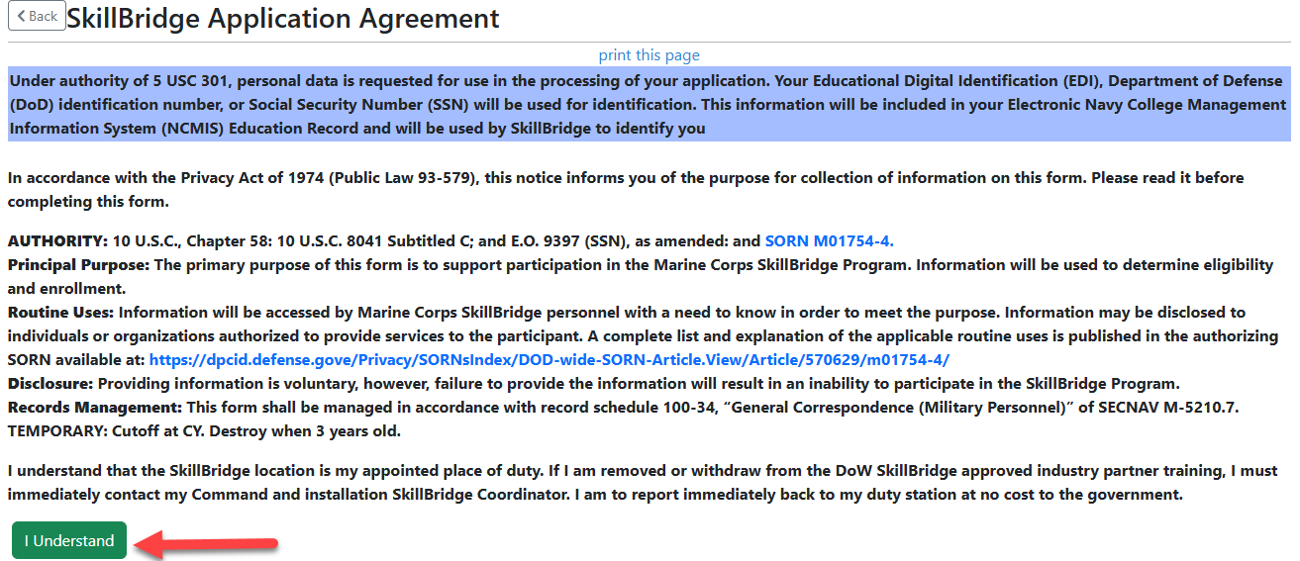
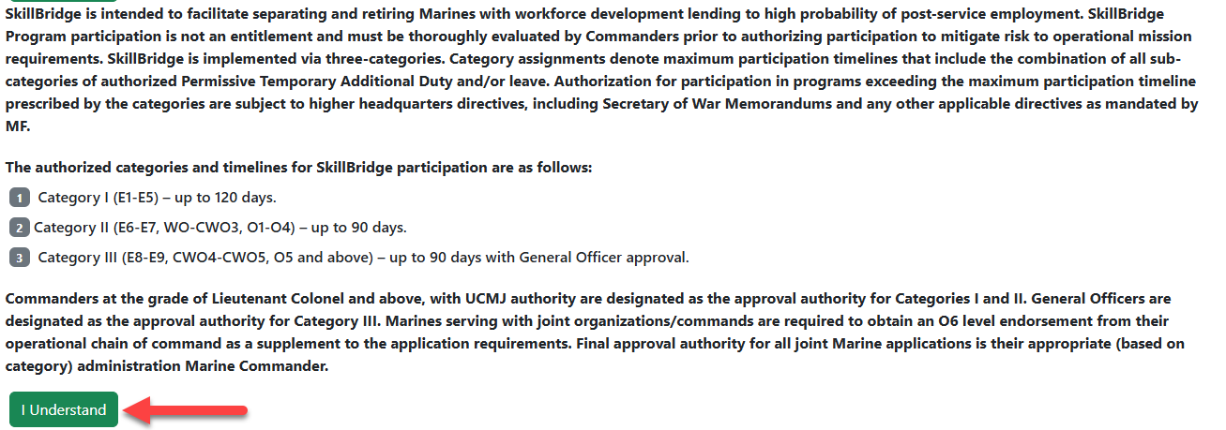
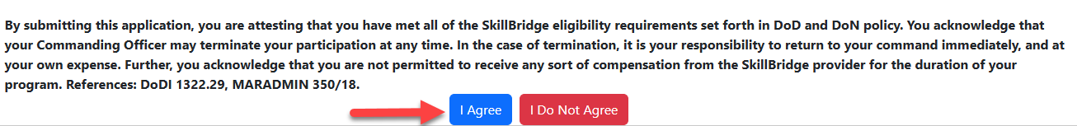
Accept Application Agreement
Click on both “I Understand” buttons and then click on the “I Agree” button to create your SkillBridge application.
The “I Agree” button will not populate until both the “I Understand” buttons are clicked.

Slide 7
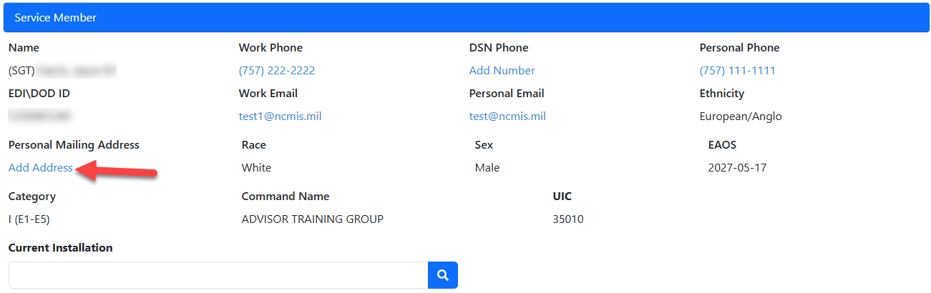
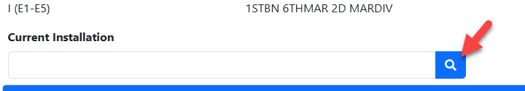
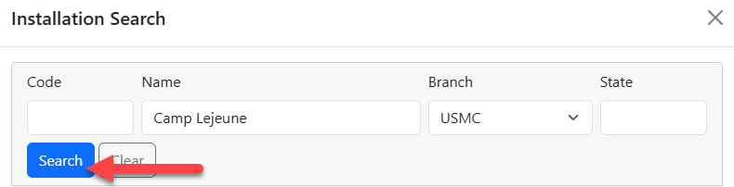
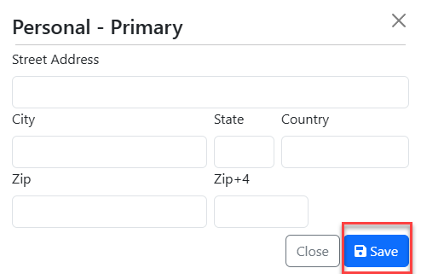
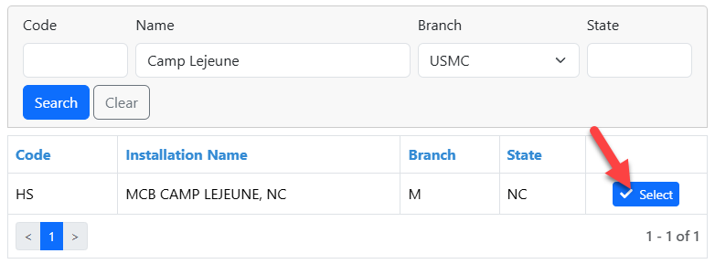
Verify Contact Information and Installation
Verify all your personal is correct, if not click on the incorrect information and a pop-up box will appear so you can change the information. After typing in the correct information click the “Save” button.
To select your Current Installation, click on the blue magnifying glass. Search for your installation by name or state. Once it populates on the screen click on the “Select” button.

Slide 8
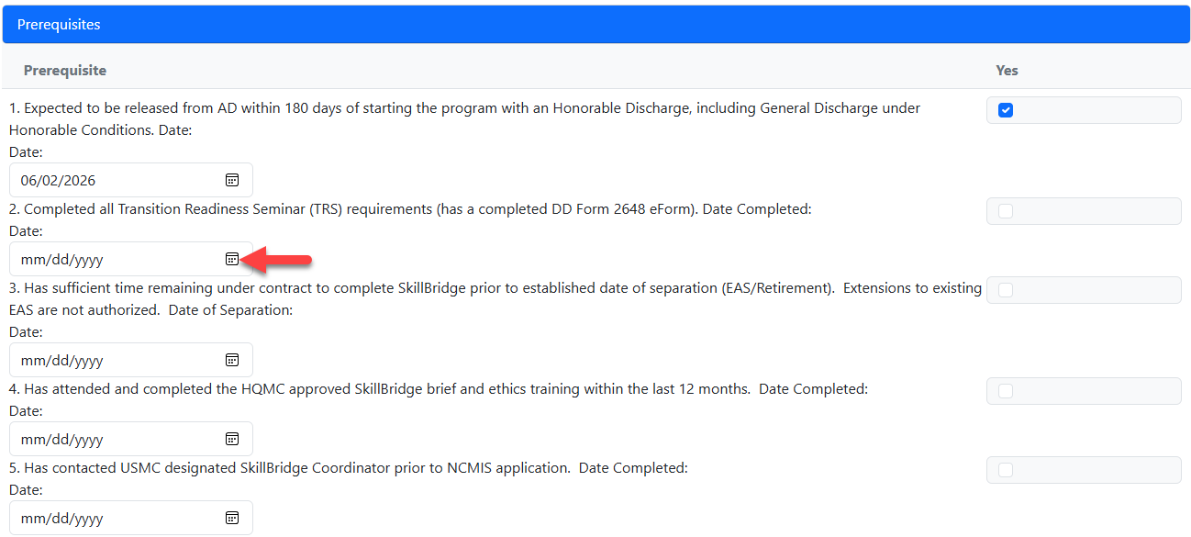
Prerequisites Section
Choose from the calendar or manually type in the date you completed each prerequisite.
  1.TRS Completion 2.Transition Process Completion 3.EAS 4.Info Brief & Ethics training 5.SB coordinator contact
All dates, for each prerequisites, must be entered before you can submit your SkillBridge application.
The “Yes” column will automatically populate once you enter in the completed date.

Slide 9
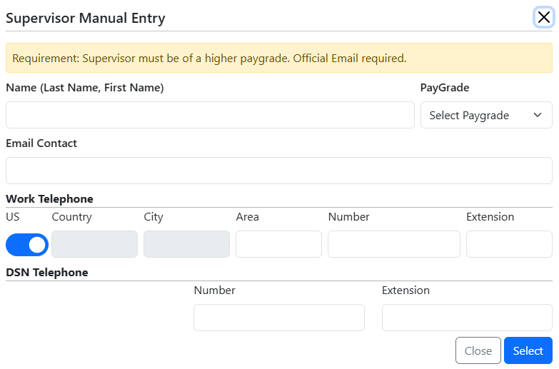
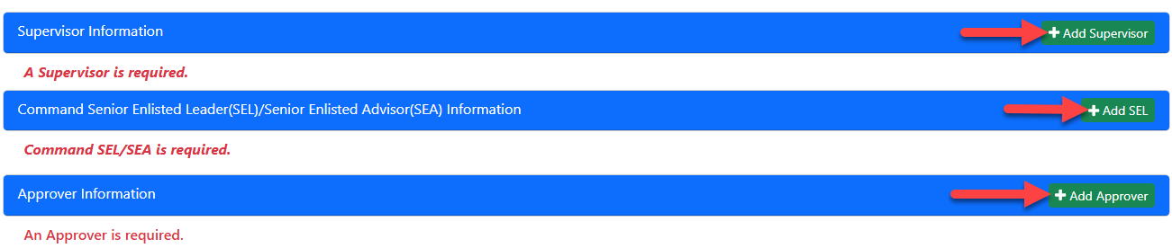
Supervisor, SEL/SEA and Approver
There are two reviewers for your SkillBridge application your supervisor and command SEL or SEA. To add them to your application, click on the “+ Add Supervisor” and “+ Add SEL”. Enter in their name, paygrade, email address and phone number then click “Select”.
The final approver is your Commander and must be grade of LtCol or above. Click on “+ Add Approver” and enter their name, paygrade, email address and phone number then click “Select”.
  Due to rank restrictions, Acting/ByDir letters are not authorized.

Slide 10
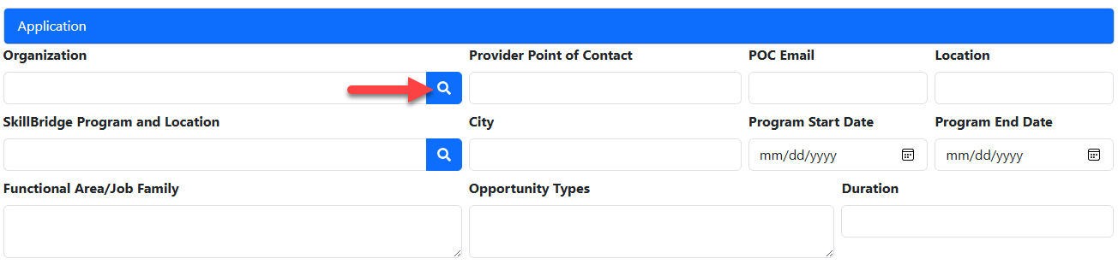
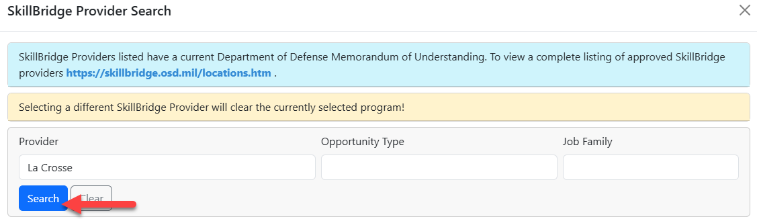
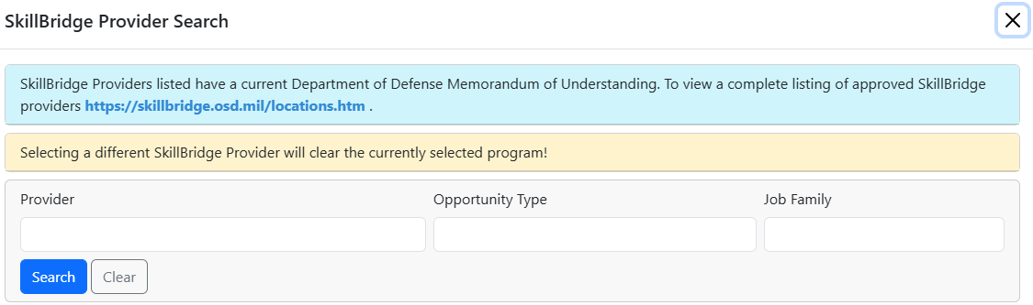
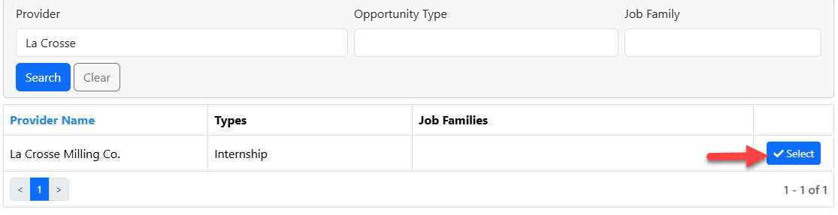
Application Section
Select an Organization you will be preforming your SkillBridge at, click on the blue magnifying glass to search for your organization. You will be able to search by name, opportunity type or job family. Click the “Search” button to find your organization.
Once located click on the “Select” button to add the organization.

Slide 11
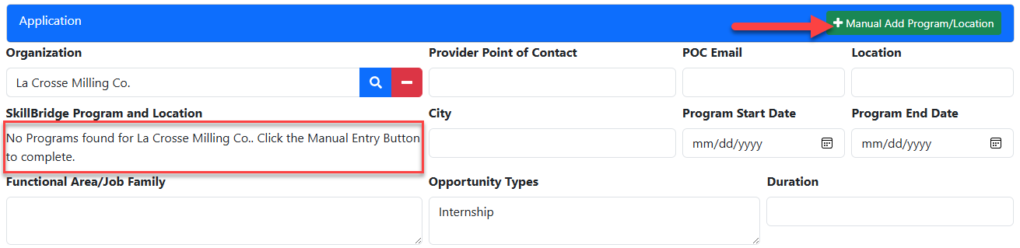
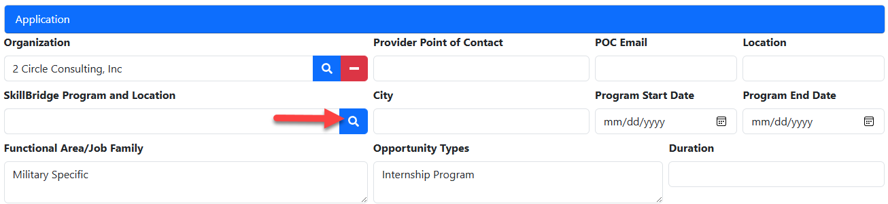
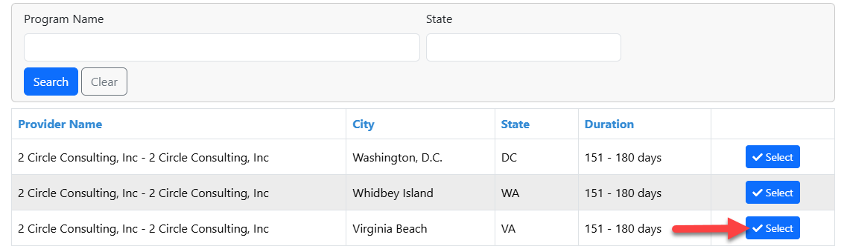
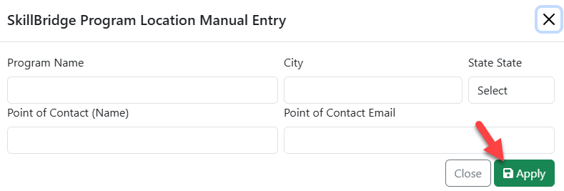
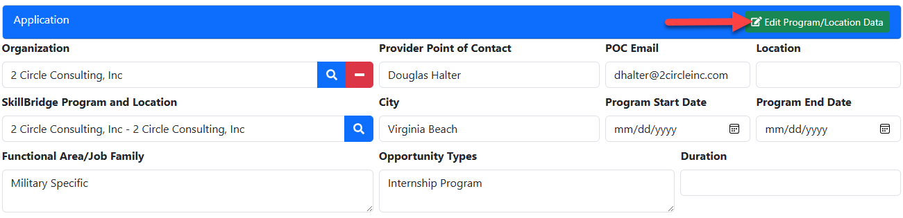
Application Section cont.
If an organization does not have a program listed, you will be able to manually add the program and location information by clicking “Manually Add Program/Location” button.
Fill in the Name, City, State and POC for the program and then hit “Apply”.
If the organization has programs listed but not the one you are applying for, just select any program and there will be an “Edit Program/Location Data” button to change the Name, City, State, or POC information, to reflect the program you are applying for.

Slide 12
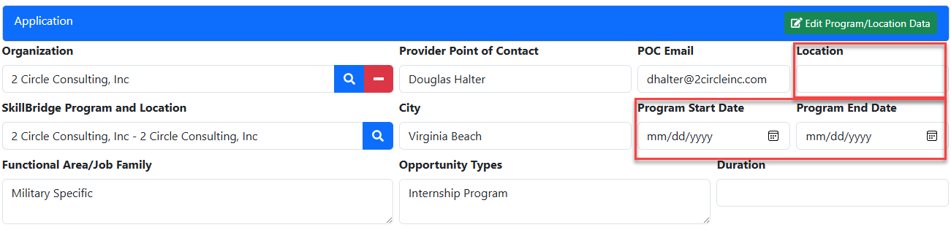
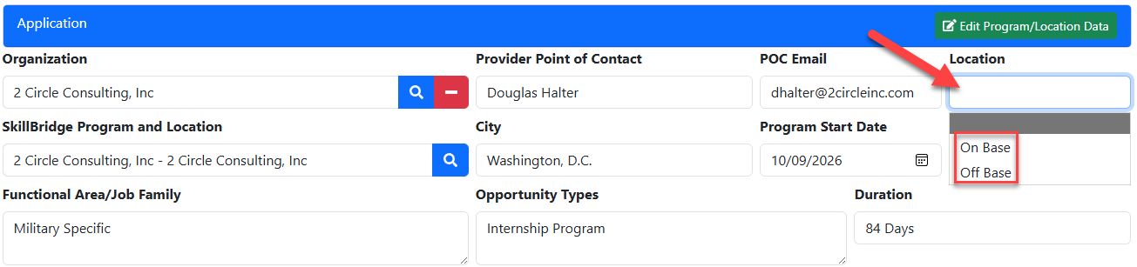
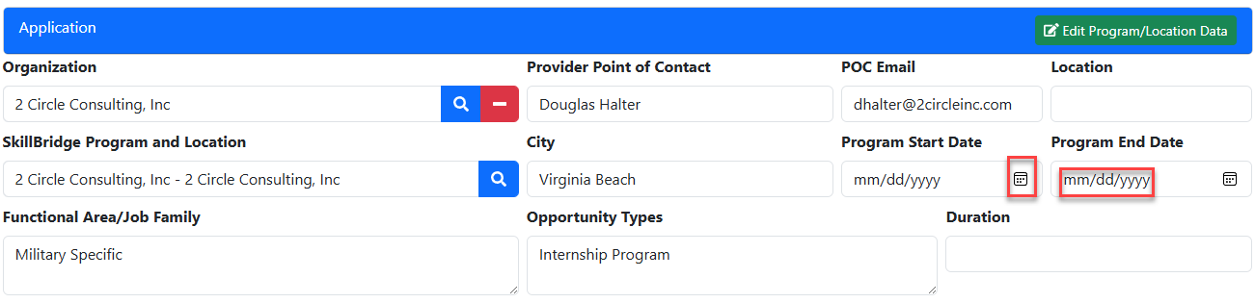
Application Section cont.
After the program is selected or added you will need to fill in the Location and Program Start and End Date. The Duration field will be automatically filled in once the program dates are entered and the application saved.
For the Location field, click inside the box and a drop-down menu will appear. Choose whether your program is on base or off base.
Use the calendar icon or manually type in the start and end date.

Slide 13
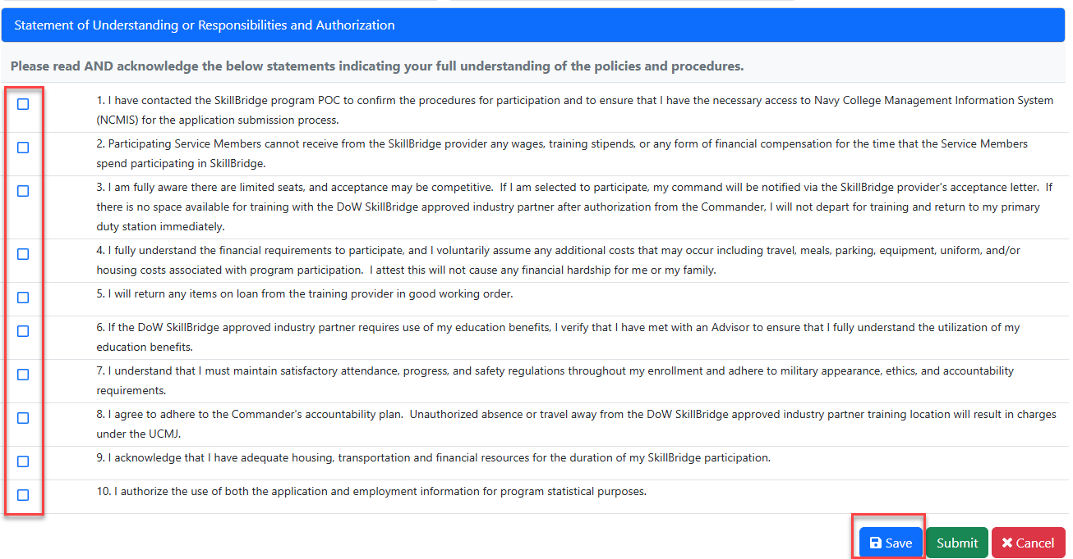
Statement of Understanding Section
After the application section there is a Statement of Understanding or Responsibilities and Authorization section.
Read all 10 statements and check the box next to each statement. All boxes must be checked before you can submit your application.
After all, have been checked click on the “Save” button to save your SkillBridge application.

Slide 14

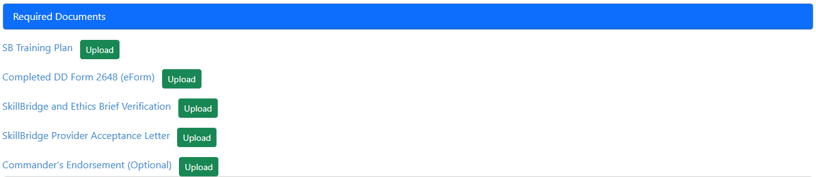
Required Documents Section
The Required Documents section is below the Prerequisites section; however, until you save your application it will have the statement “Application must be saved before uploading files.”
Once you save your application the 4 required documents will be listed with an “Upload” button next to each required document.
Use the “optional” field for uploading special considerations, Joint-command approvals, etc.
Click on the “Upload” button to attach each of the required documents. You will not be able to submit your application until all 4 documents are uploaded.

Slide 15
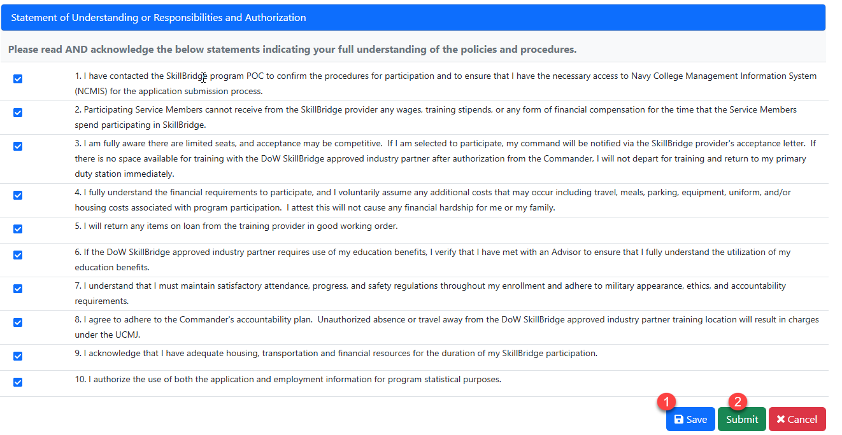
Submit the SkillBridge Application
After all sections are filled out, all boxes checked and all documents uploaded, click the “Save” button one last time to save your application.
After the save button has been clicked, click on the “Submit” button to submit your SkillBridge application to your SkillBridge coordinator.

Slide 16
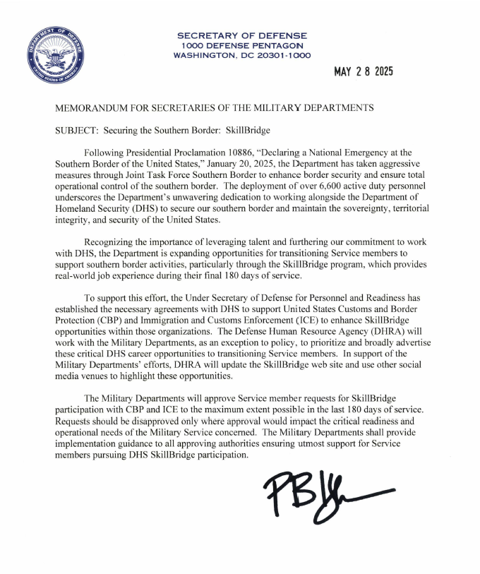
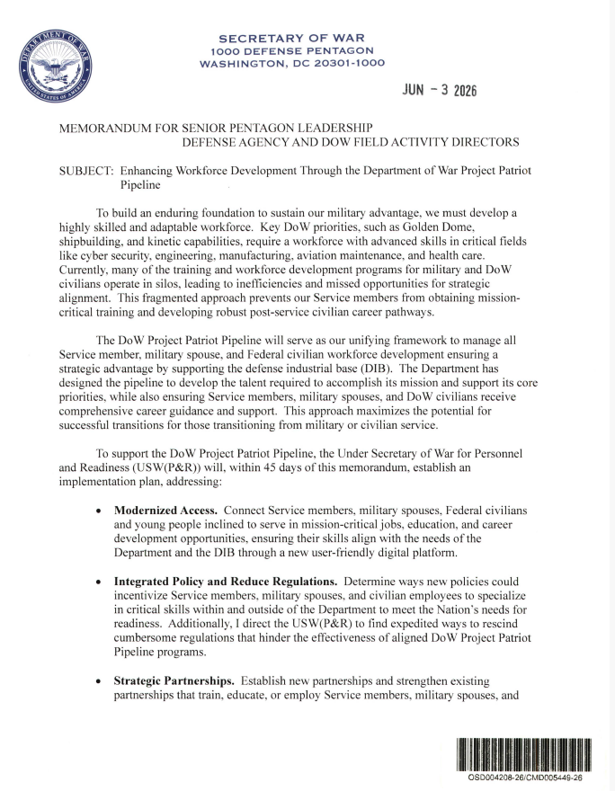
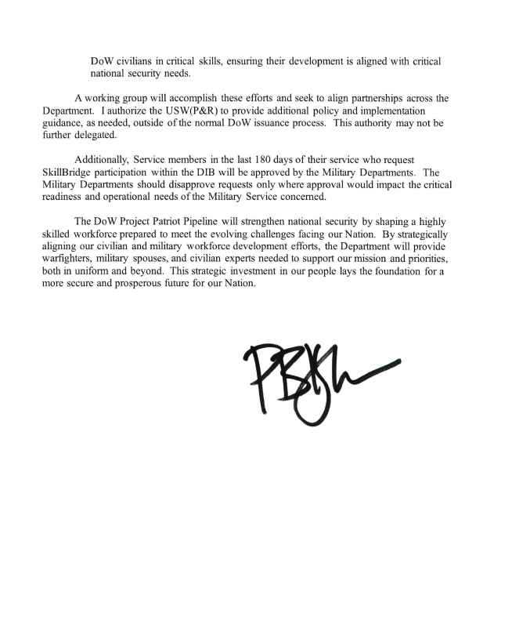
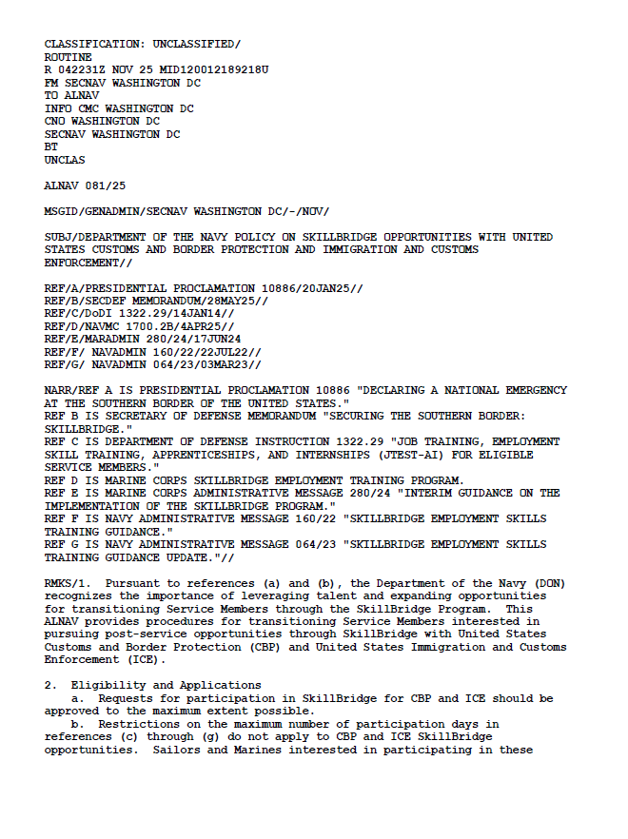
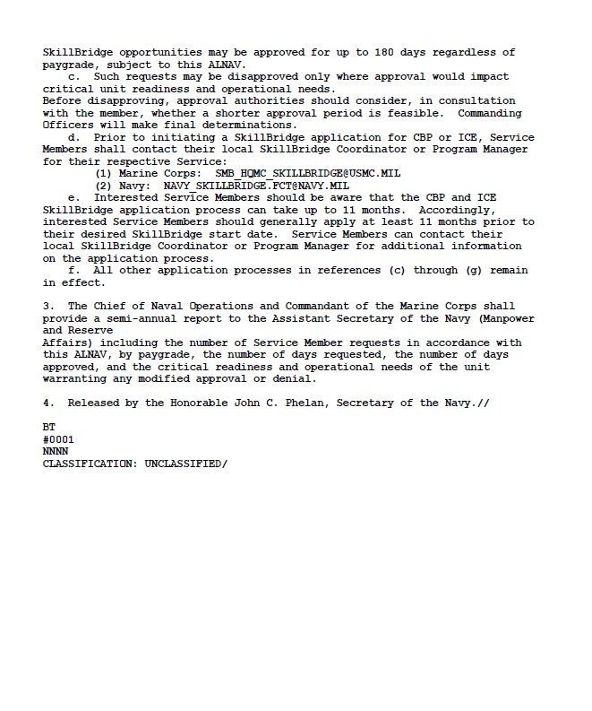
180-Day Opportunities
DIB and CBP-ICE opportunities allow Marines to participate in SkillBridge up to 180 days regardless of rank.
After completing your application, you must E-mail HQMC to request this consideration. hqmc_skillbridge@usmc.onmicrosoft.com
  Marines must provide the training plan and acceptance letter when requesting 180-day participation.

Slide 17
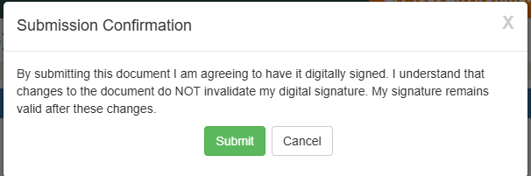
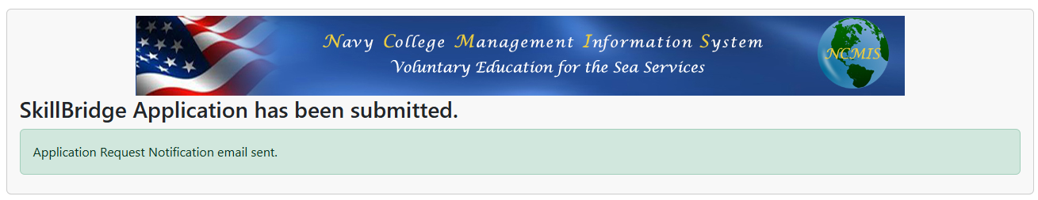
Submission Confirmation
Read the Submission Confirmation statement and click the Submit button to digitally sign your application and send it to your supervisor for further routing.
Confirmation that the application has been submitted appears on the screen.

Slide 18
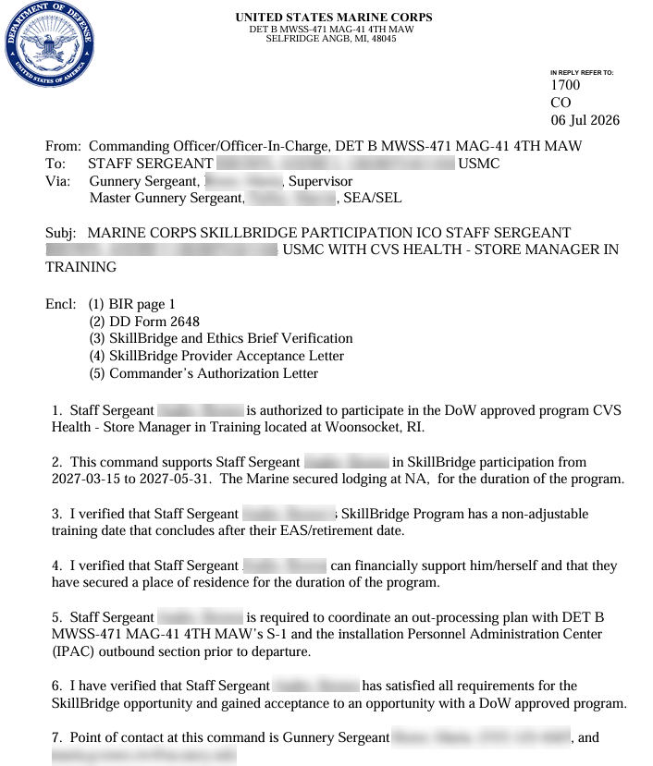
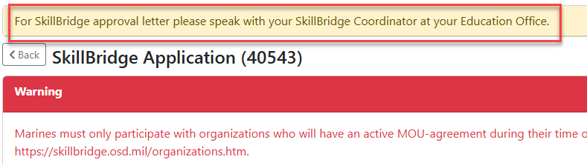
Print Authorization Letter
Once your request has been authorized by your Command Approver, you will need to visit your SkillBridge coordinator at your Education Office to obtain a copy of your authorized SkillBridge letter. The SkillBridge coordinator must brief you before you start your SkillBridge program.
There will be a banner at the top of the application directing you to visit the SkillBridge coordinator to obtain the approved letter.

Slide 19
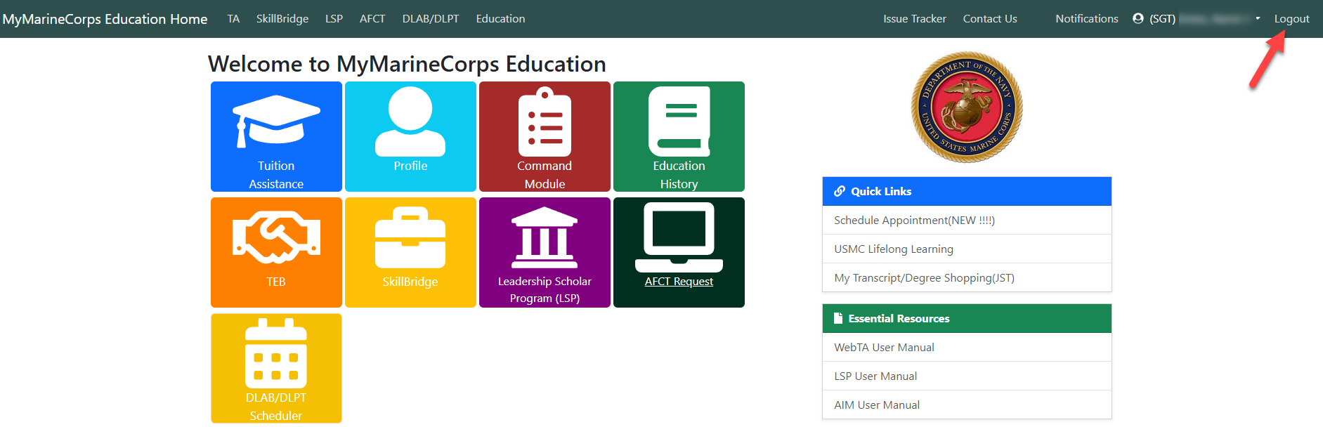
Log Out of MyMarineCorps Education
Log out of MyMarineCorps Education by using Logout in the upper right corner when you have finished your session.
This is particularly important in cases when Marines share computer workstations.

